Slide 1
Fiverr - TBD
Market place
Project Definition
Team Members:
Emanuel Ben Hamo, Rotem Carmon, Vova Eygel

Slide 2
Highlights
Product Name: Fiverr - TBD
Product Short Description:
Marketplace for web design and development service
Users:
Guest users, Sellers, Buyers, Admin
Key features:
Offer web design & development services, purchase web services, chat between buyers and sellers,
Show sellers reviews & description
Guest mode:
Guest can browse all services offered in the marketplace and look at specific seller details, information & reviews

Slide 3
Main Pages
Home page
Browse between station’s categories and select a station
Station list
See all stations, filter, search by name / genres etc
Station
See songs list, promote/demote songs, add songs, chat with team members
Station creator view
Login/Signup
Admin of all stations
Marketing message
Music Category
Music Category
Music Category
Music Category
Filter and search
station
station
station
station
station
station
song
chatt
song
song
song
song

Slide 4
Main Flows
Marketing message
song
chatt
Music Category
song
Music Category
song
Music Category
song
Music Category
song
Filter and search
station
station
station
station
station
station
Clicking a station-preview item on the home screen or at the stations page – user is directed to the station page and music starts to play

Slide 5
Main Pages UX

Slide 6
Home page – Top Fold, Below Fold
Listen and communicate with others
(background image here)
LOGO
Login
Top fold
Top fold
Create Station
Top rated stations
See all >
Station
Station
Station
Station
Station
HipHop
See all >
Station
Station
Station
Station
Station
Rock
See all >
Station
Station
Station
Station
Station

Slide 7
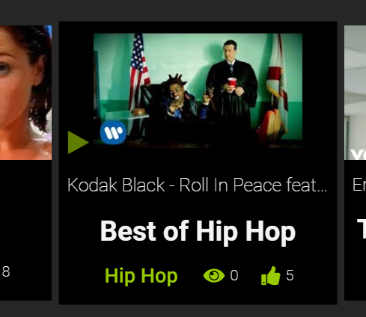
Main component – Music Station Preview
Pay while staying at the home page
Youtube thumbnail
Artist + Song name
Click anywhere to enter the station
Station name
likes
Genre / category
Currently listening count

Slide 8
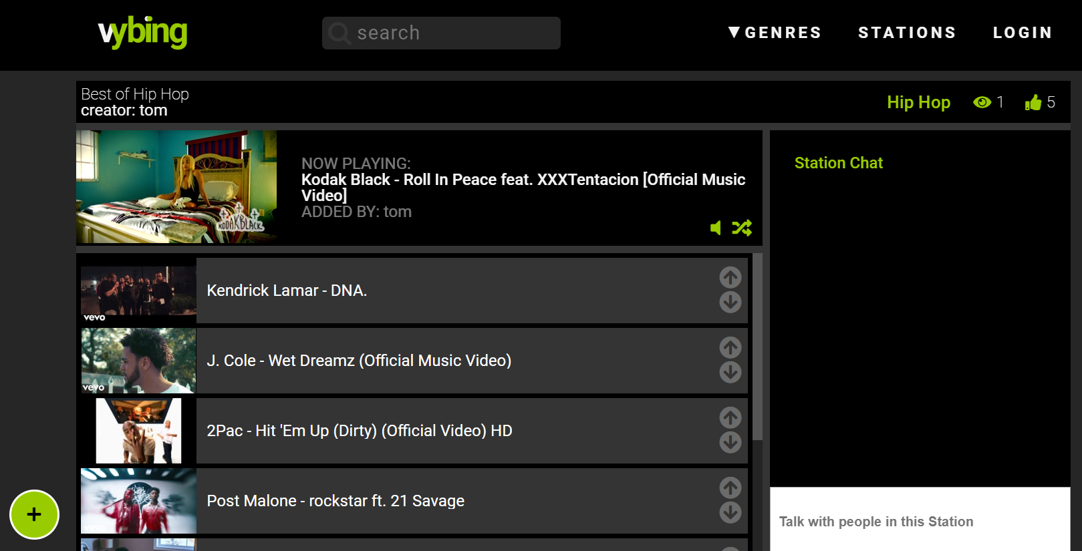
Station Page
Stations
Now playing
chat messages
Appear here
Dudu: amazing song
Duda : amazing dud
Rachel : not so sure about his music
Input for chat messages
Add songs
Artist + song name
Mode song up / down

Slide 9
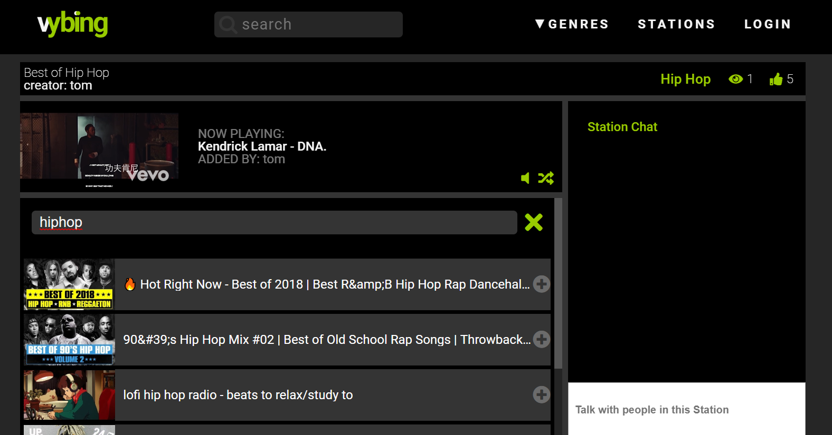
Station Page > Add Song
Stations
Close “add song”
Dudu: amazing song
Duda : amazing dud
Rachel : not so sure about his music
Search songs
Add to station

Slide 10
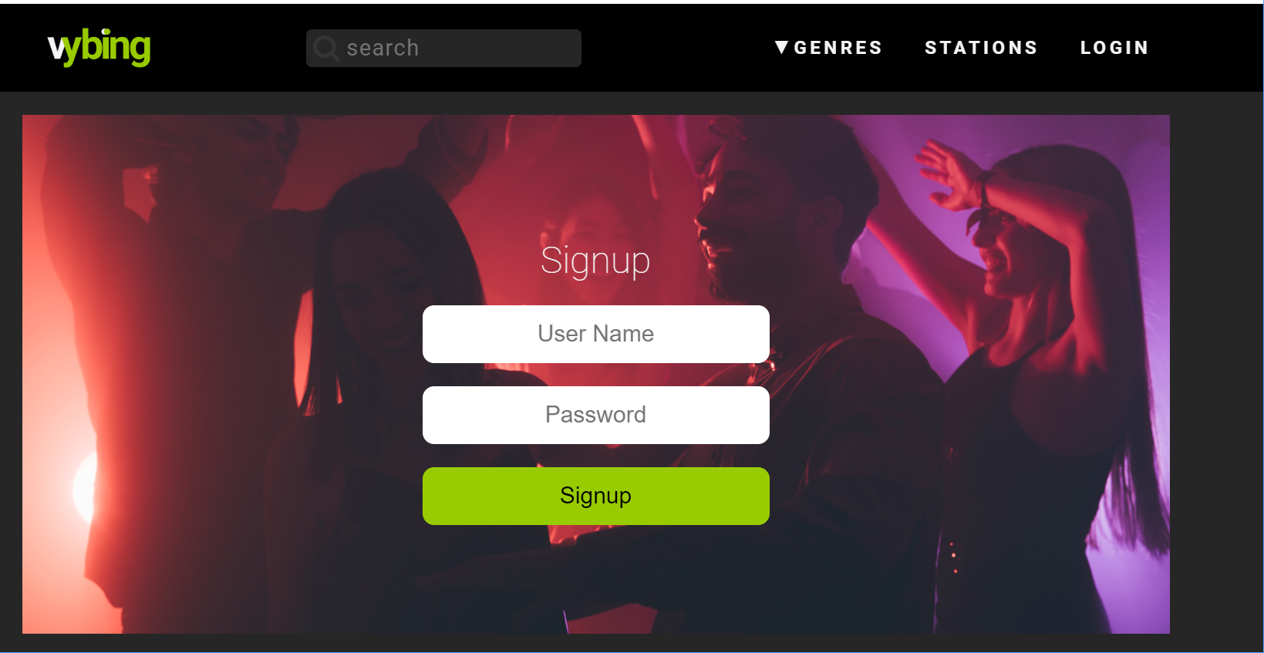
Login Page
Stations

Slide 11
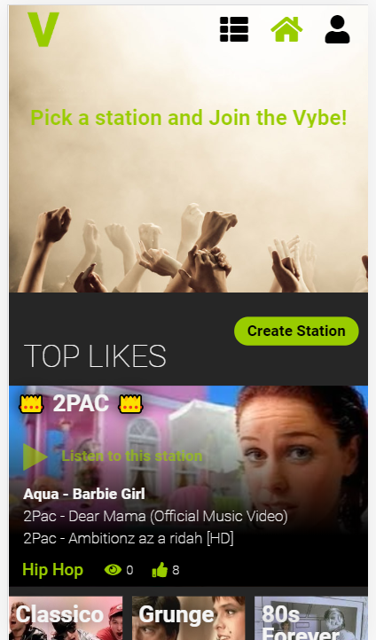
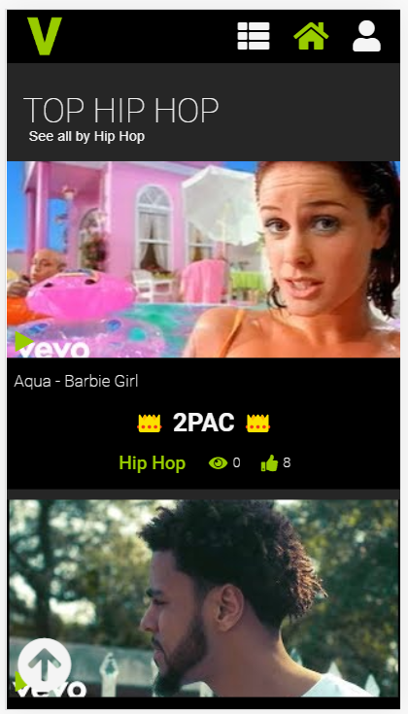
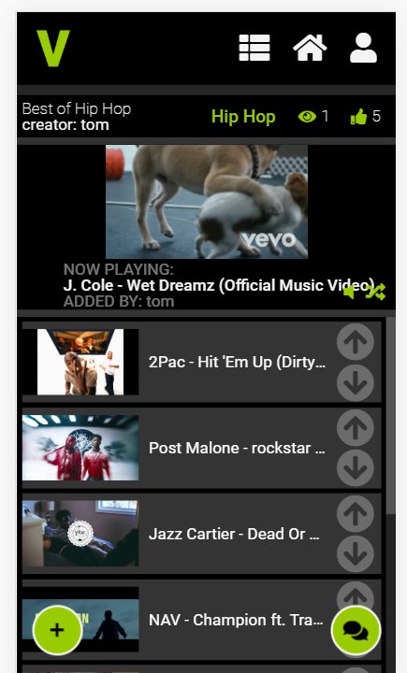
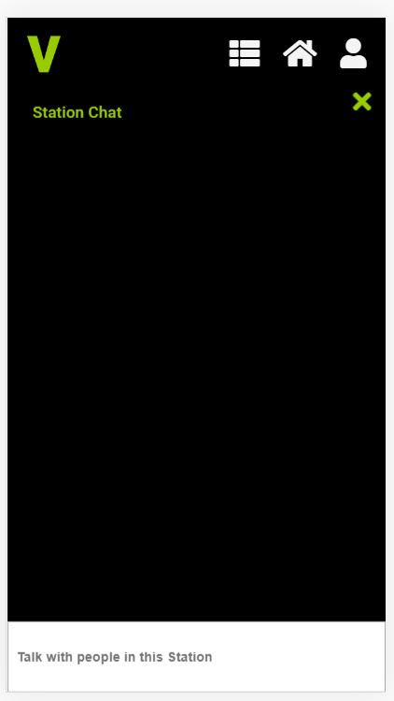
Main pages - mobile view

Slide 12
GUEST Mode
User is asked to login when: Save NEW station
How Guests appear:
“Guest”

Slide 13
Special Functionality for Demo
No special functionality

Slide 14

Technical Design

Slide 15
Data Model

Slide 16
User
{
"_id": "u101",
"fullName": "Orly Amdadi",
"userName": "orly@amdadi.com",
"password": "tinkerbell",
"isAdmin": true,
"followers": [{minimal-user}, {minimal-user}],
"imgUrl": "http://some-img"
}

Slide 17
Minimal User (saved in other entities)
{
"_id": "u101",
"fullName": "Orly Amdadi",
"imgUrl": "http://some-img"
}

Slide 18
Station
{
"_id": "5c09",
"name": "Funky Monks",
"tags": [
"Funk",
"Happy"
],
"createdBy": {
"_id": "u101",
"fullName": "Puki Ben David",
"imgUrl": "http://some-photo/"
},
"likedByUsers": [{minimal-user},{minimal-user}],
"songs": [
{
"title": "The Meters - Cissy Strut",
"id": "s1001",
"imgUrl": "https://i.ytimg.com/vi/4_iC0MyIykM/mqdefault.jpg",
"addedBy": {minimal-user}
},
{
"title": "The JB's - Pass The Peas",
"id": "mUkfiLjooxs",
"imgUrl": "https://i.ytimg.com/vi/mUkfiLjooxs/mqdefault.jpg",
"addedBy": {}
}
]
}

Slide 19
Store - UserModule
State
loggedinUser
Getters
user, isAdmin
Actions
login
logout

Slide 20
Store - StationModule
State
stations
currStation
Getters
stations
currStation
Actions
joinStation
likeStation
addSong
removeSong
reorderSongs

Slide 21
Socket
Per Station Socket
Socket is connected when entering a specific station and closed when leaving a station

Slide 22
Socket Protocol
on
stationJoined (user)
stationLeft(user)
playlistUpdated (playlist – an array of songs)
activeSongChanged (songId, time)
newChatMsg (msg)
emit
joinStation (stationId)
leaveStation (stationId)
updatePlaylist(playlist)
changeActiveSong (songId, time)
sendMsg (msg)

Slide 23
Pages and Components

Slide 24
Pages
Page | Description | Routing
Homepage | Shows top rated stations and then stations per genre sorted by popularity | /
Stations | This page has query string parameter and shows specific stations, for example: /stations?genre=Hiphop Or: /stations?q=hip | /stations
StationDetails | Shows details about the station and the live playlist, this page uses the socket to keep all listeners on real time and to chat | /station/s101
StationEdit | Allow creating, updating (and deleting) a station including the playlist | /station/edit/:id?
UserDetails | User profile including created and liked stations | /user/u101
LoginSignupPage | Login / Signup | /signup

Slide 25
Components
Component | Props | Emits | Description
stationPreview | Station | liked | Preview of the station with a link to station page
stationList | Stations | Liked | List of stations
songSearch |  | Song | Allow the user to find a song and emit to parent
chatApp |  |  | Allow users to chat

Slide 26
Used Techs and APIs
Ajax and REST API
CRUDL for stations with axios and Node.js
Authentication
User/password and server session
Storage
Cloudinary to store users profile and station images
Database
Mongodb on Atlas cloud databases
Web Sockets
Multi room with a Socket per station
Youtube API
Add and play songs from Youtube based on user search
Share
Share to Facebook (if time permits)

Slide 27
Thanks

